Slide 1

TEAM MEMBERS
MEMBERS OF TEAM AURORA
TEAM AURORA
“None of us is as smart as all of us”
Gowtham.R- gowtham.raghavan@aspiresystems.biz
Manimaran.V – manimaran.venkat@aspiresystems.biz
Girishkumar .R– girish.ravi@aspiresystems.biz
Ponvizhi .U- ponvizhi.uday@aspiresystems.biz
Venkateshwaran.M – venkatesh.malai@aspiresystems.biz
Sandhya.S – sandhiya.sakthivel@aspiresystems.biz
Pooja.S – pooja.Sakthivel@aspiresystems.biz
Ranjith.R – Ranjith.ramasamy@aspiresystems.biz
Sriram.M– sriram.manis@aspiresystems.biz
Mohammed Irfan.S - irfan.sadiq@aspiresystems.biz
SOLID PRINCIPLES

Slide 2
Solid Principle
Single-responsibility principle : A class should only have a single responsibility, that is, only changes to one part of the software’s specification should be able to affect the specification of the class.
Open-closed principle : Software entities … should be open for extension, but closed for modification.
Liskov substitution principle : Objects in a program should be replaceable with instances of their subtypes without altering the correctness of that program.
Interface segregation principle : Many client-specific interfaces are better than one general-purpose interface.
Dependency inversion principle : One should depend upon abstractions, [not] concretions.

Slide 3
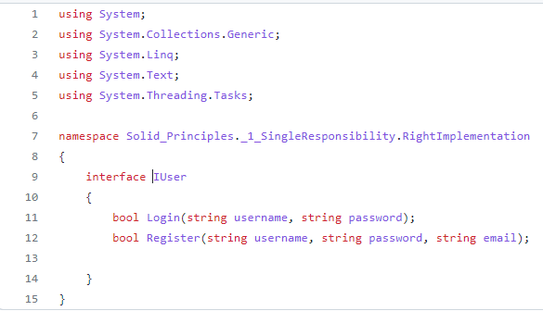
Single-responsibility principle
Notes:
This slide is only for the trainer… You can display the poll from GTM and after the poll is taken, share the result, connect the poll result with the topic. Once done, you can hide the poll so that the PPT is visible.
I have created the poll in the GTM webinar.

Slide 4

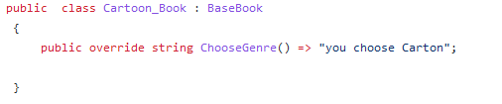
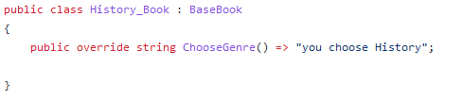
Open-closed principle

Slide 5
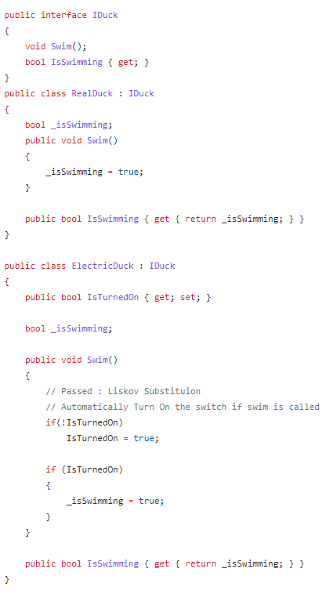
Liskov substitution principle

Slide 6
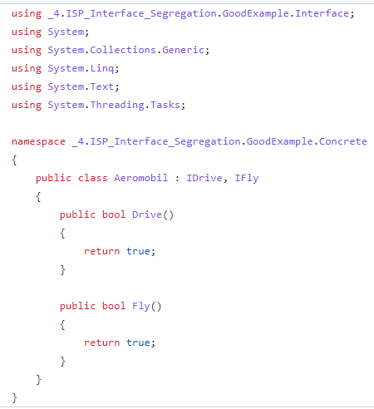
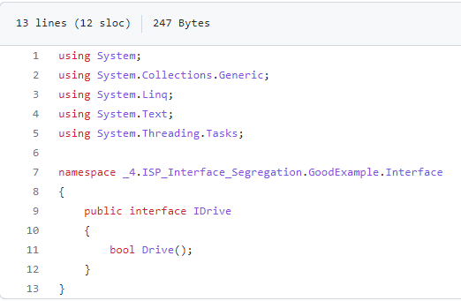
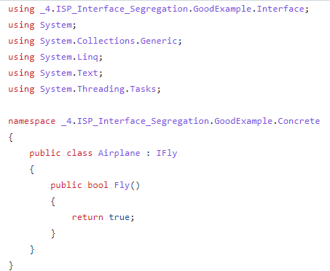
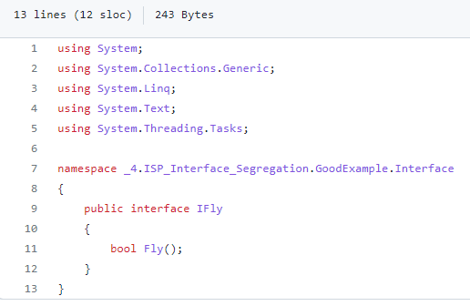
Interface segregation principle

Slide 7
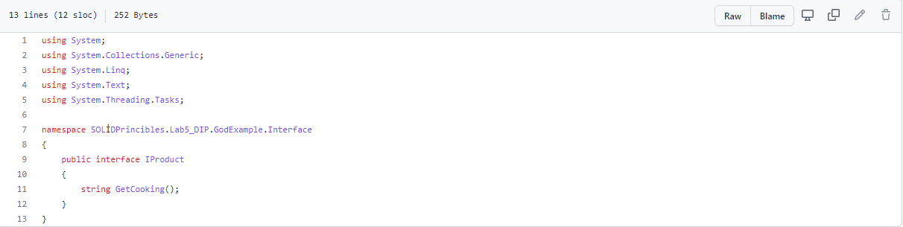
Dependency inversion principle

Slide 8


